Slide 1
ENGR 12
Dr. Mandala
Notes:
Down

Slide 2
FILE commands
Command | Meaning
FILE | FILE *[filenamevariable]; EXAMPLE: FILE *fdata fdata is a file pointer FILE definition included in <stdio.h> FILE is a type name, like int or char
fopen | fdata = fopen(name, mode); name: a character string containing the name of the file mode: a character string, which indicates how one intends to use the file; allowable modes include read (“r”), write (“w”), and append (“a”)
fclose | fclose(fdata); inverse of fopen breaks the connection between the file pointer (fdata) and the external name that was established with fopen, freeing the file pointer for another file
fscanf | fscanf(fdata, format, arg1, arg2, …); identical to scanf except that the first argument is a file pointer that specifies the file to be read or written
fprintf | fprintf(fdata, format, arg1, arg2, …); identical to printf except that the first argument is a file pointer that specifies the file to be read or written

Slide 3
File Modes
Syntax: variable_file_pointer = fopen (“filepath”,”mode”);
Mode | Description
r | Read mode only. If file exist, it opens file to read. Does not write to storage. If file does not exist, returns NULL.
w | Write mode only. If file exists, it erases current data. Writes new data to storage. If file does not exist, creates a new file.
a | Append mode only. If file exists, it opens file. Writes new data to end of file in storage. If file does not exist, creates a new file.
r+ | Read and write mode. If file exists, it opens file to read. Erases current data and writes new data to storage. If file does not exist, returns NULL.
w+ | Similar to r+ Only difference: If file does not exist, creates a new file.
a+ | Similar to w+ Only difference: read occurs from beginning of file, write occurs at end of current data
rb,rb+,wb, wb+,ab,ab+ | Corresponding modes for binary files

Slide 4

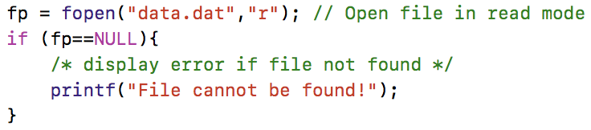
How to check for
End of data bit or “End Of File”:
A state of file that represents its end.
fscanf returns EOF if reached, else returns number of scanned items.
In STDIO, EOF is a defined term. EOF is displayed as -1 when converted to integer.
File does not exist:
fopen returns NULL
In STDIO, NULL is defined as 0.

Slide 5
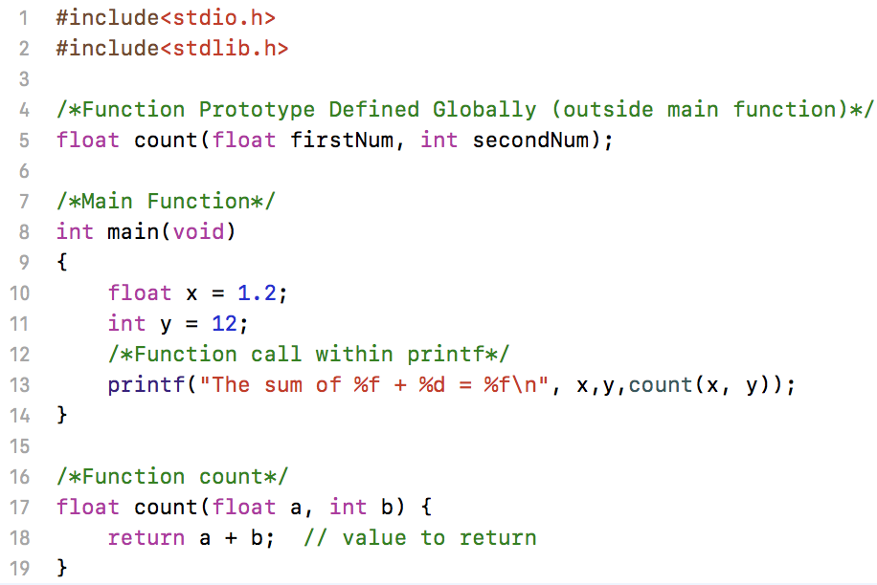

Functions

Slide 6
Functions
Function definition: Lets compiler know that a function of this syntax exists to set rules for its use.
Variable names are optional in definition, their types are not.
float count(float, int);
Function calls can be made within scope of the function definition. Here function was defined outside of main(): it is a global function i.e. any code written in this file can access it!
Function declaration should contain the variables to be used within it.
return command returns the value back to its caller.

Slide 7
Function Definition
Define the function syntax and data types used [IMPORTANT]
returntype funcName(argtype);
returntype: data type of function output (return value)
funcName: any acceptable function name in C
argtype: list of data types of argument passed
data types: int float char struct
semi-colon: required in definition
NOTE: Location of Step 1 in code matters
Defined outside main function makes this function definition available for any function.
Defined inside main function makes this function definition available only for main function.
Defined inside any other function makes it available only in that function.

Slide 8
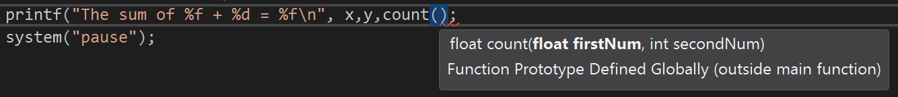
Function Definition
float count(float, int);
float count(float firstNum, int secondNum);
Both the above definitions are valid!
If a datatype for function return is not provided, compiler assumes the function returns an integer.
It is a good practice to include some variable name in definition
This helps IDE to prompt their name while you invoke the function within the code:

Slide 9
Examples
Prototype examples | Meaning
void function_name(void) | no argument(s) passed into the function; no value returned common application: display some type of printout or header
void function_name(int,int,…) void function_name(int,double,…) void function_name(char,…) ⋮ | argument(s) passed into the function; no value returned common application: have a function calculate some value or perform some self contained task, such as printing results
int function_name(void) double function_name(void) ⋮ | no argument(s) passed into the function; one value returned common application: have a function collect data from a user
double function_name(int,double,…) int function_name(double,…) ⋮ | argument(s) passed into the function; one value returned common application: numerous; typically used to modularize a program by taking large sections of a code and converting it to a function

Slide 10
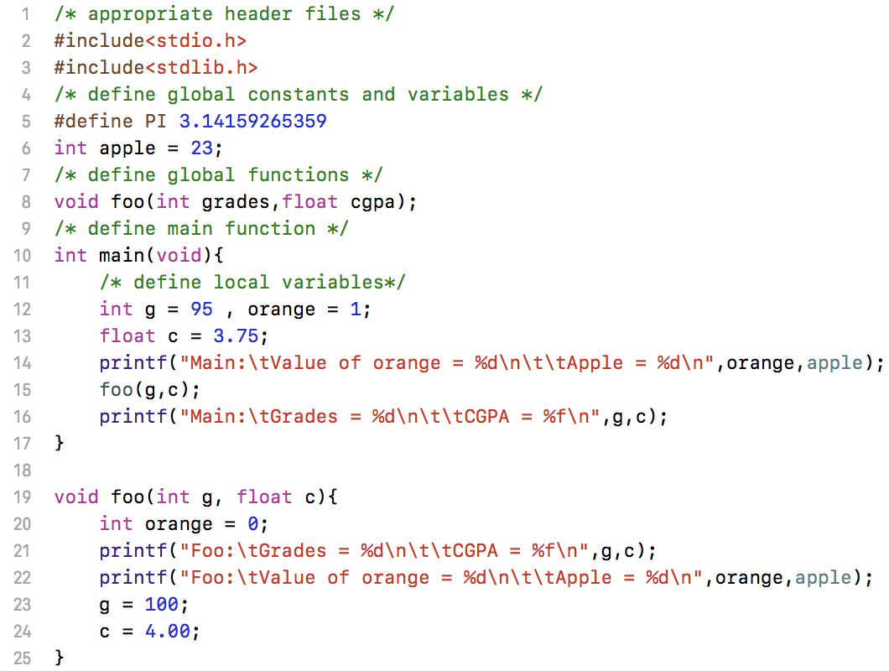
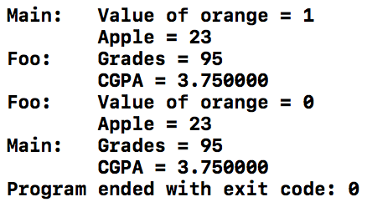
Global and local variable
Global: Defined outside any function. Available to all functions.
Local: Defined inside a function. Available only to that function.

Slide 11
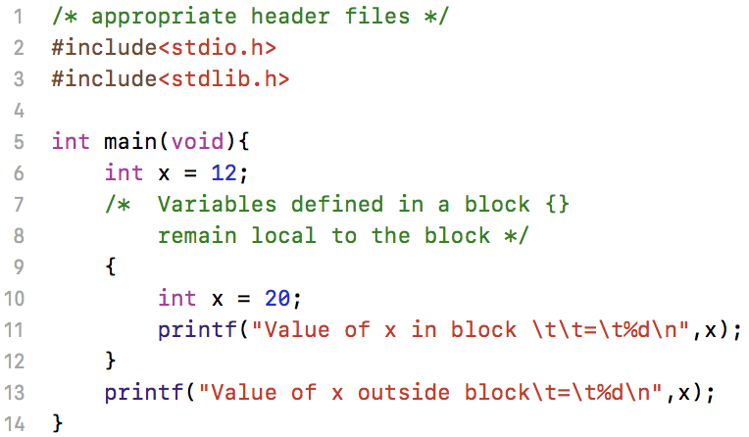

Block Structure
Variables created in a block { } remain local to the block and disappear at end of block.

Slide 12
Download Handout

